Slide 1
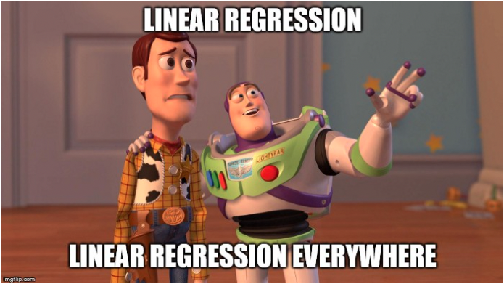

Slide 2
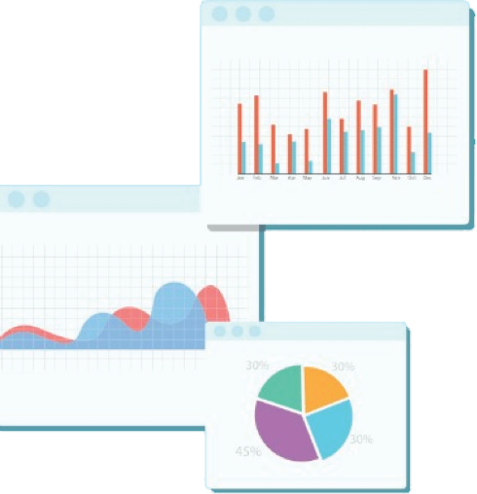


Welcome to Week 6
Lecture 1!
Data Science in Python &
Machine Learning

Slide 3
Warm-Up
What is the difference between
Regression And Classification?
Put your answer in chat.

Slide 4
Learning Goals
After this class you will be able to:
Use a linear regression model with a pipeline
Evaluate a regression model using multiple appropriate metrics.
Compare a fitted model’s performance to a baseline.

Slide 5
Linear Regression
Most commonly used machine learning algorithm
Y = b₁x + b₀
Model assumes a linear relationship between the input and output

Slide 6
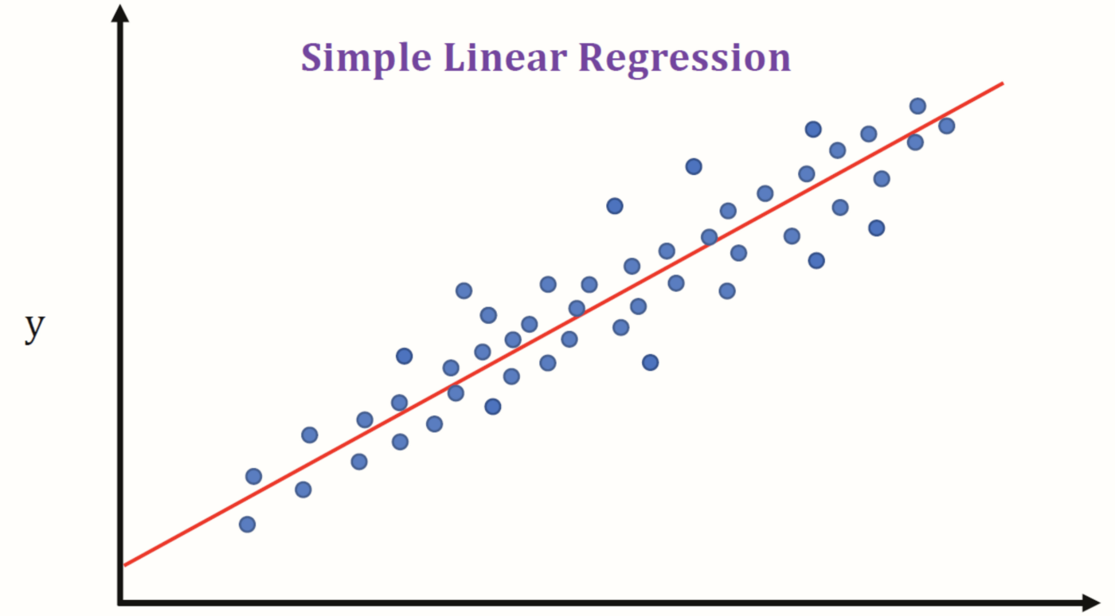

Slide 7
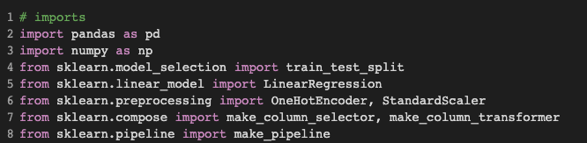
Using a Model with a Pipeline

Slide 8
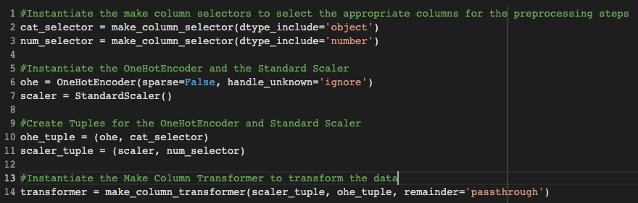
Using a Model with a Pipeline Continued

Slide 9
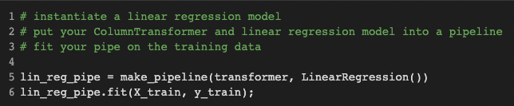
Using a Model with a Pipeline Continued

Slide 10
Evaluating Regression Models
How do we know if our model is any good?

Slide 11
Regression Evaluation Metrics
Mean Absolute Error (MAE)
Mean Squared Error (MSE)
Root Mean Squared Error (RMSE)
R-Square (R²) or (R2) or (R^2)

Slide 12
What does ‘Error’ mean in predictive modeling?

Slide 13
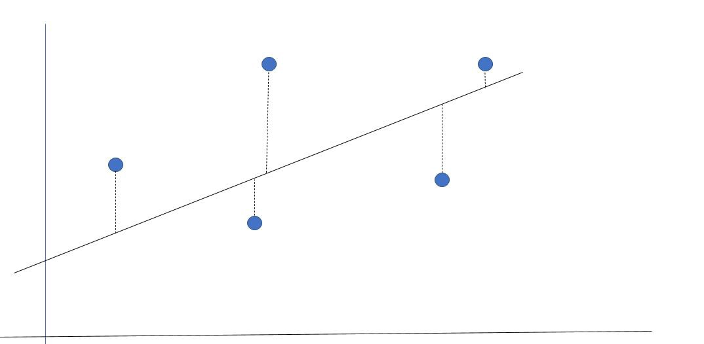
The line represents the prediction.
The blue dots represent the actual values.
The distance along the y axis between each dot and the line is the error.
y
Error 1
x

Slide 14
Notice that sometimes the prediction is over and sometimes it is under
y
Error 1
x

Slide 15
Let’s look at a regression problem where we are predicting price in dollars.
True Value | Prediction
2 | 5
6 | 6
7 | 4
8 | 3
10 | 14
9 | 10
Note: These number are just examples for easy calculating, they don’t match the previous graph

Slide 16
Error is the difference between the prediction and actual value
If we wanted to add up each of the errors, we would have positive errors and negative errors cancelling each other out!
Mean Error | 0
True Value | Prediction | Error
2 | 5 | -3
6 | 6 | 0
7 | 4 | 3
8 | 3 | 5
10 | 14 | -4
9 | 10 | -1
Total |  | 0
0/6 = 0
Adding the errors results in an average error of 0!
We know our predictions weren’t perfect, so this won’t work!

Slide 17
One way to avoid positive and negative values cancelling is take the absolute value of each error before finding the average
True Value | Prediction | Error | Absolute Error
2 | 5 | -3 | 3
6 | 6 | 0 | 0
7 | 4 | 3 | 3
8 | 3 | 5 | 5
10 | 14 | -4 | 4
9 | 10 | -1 | 1
Total: |  | 0 | 16
Mean Error | 0
Mean Absolute Error | ≈ 2.67
16/6 ≈ 2.67
MAE is in the same units as the original data!

Slide 18
Another way to deal with positive and negative errors is to square each error before finding the average. The result is always positive
True Value | Prediction | Error | Absolute Error | Squared Error
2 | 5 | -3 | 3 | 9
6 | 6 | 0 | 0 | 0
7 | 4 | 3 | 3 | 9
8 | 3 | 5 | 5 | 25
10 | 14 | -4 | 4 | 16
9 | 10 | -1 | 1 | 1
Total: |  | 0 | 16 | 60
Mean Error | 0
Mean Absolute Error | ≈ 2.67
Mean Squared Error | 10
16/6 ≈ 2.67
60/6 = 10
Mean Squared Error is NOT
In the same units as the true values.

Slide 19
In order to return the squared error to the same units as the true values, we can take the square root.
True Value | Prediction | Error | Absolute Error | Squared Error
2 | 5 | -3 | 3 | 9
6 | 6 | 0 | 0 | 0
7 | 4 | 3 | 3 | 9
8 | 3 | 5 | 5 | 25
10 | 14 | -4 | 4 | 16
9 | 10 | -1 | 1 | 1
Total: |  | 0 | 16 | 60
Mean Error | 0
Mean Absolute Error | ≈ 2.67
Mean Squared Error | 10
Root Mean Squared Error | ≈ 3.16
16/6 ≈ 2.67
60/6 = 10
√10 ≈ 3.16
Root Mean Squared Error is
in the same units as the true values.

Slide 20
Benefits and Drawbacks
MAE: Uses same units, but does not punish large errors.
MSE: Punishes large errors, but not in same units
RMSE: Punishes large errors AND in same units.

Slide 21
R² value
While MAE, MSE, and RMSE scores are all specific to the particular data set, there IS a metric that can be interpreted similarly on any data set.
This is the R² value. (The coefficient of determination.)
It is usually given as a decimal value, but it is usually interpreted as a percent. For example, an R² of 0.95 means that the model explains 95% of the variation in y using the features
A mean value baseline will always score R² of 0.
R² will never be higher than 1 no matter what the units of the data set.
Notice that unlike our other metrics, a higher R² indicates a better result!
REGRESSION METRICS ARE ONLY FOR REGRESSION MODELS

Slide 22
Baseline Models
Using the three metrics discussed so far, how do you know if you have a “good” model?
For example, the same RMSE might be “good” for one data set and horrible for another.
It is very specific to the particular data set.
Using a baseline model is a great way to help you interpret MAE, MSE, or RMSE.

Slide 23

There is NO set rule for how to develop a baseline model.
For regression problems, one common approach is to see how well your model compares to simply predicting the mean of y for every value in your training set.
Metric | Model | Baseline
Mean Error | 0 | 0
Mean Absolute Error | ≈ 2.67 | 2
Mean Squared Error | 10 | ≈ 6.67
Root Mean Squared Error | ≈ 3.16 | ≈ 2.58
True Value | Baseline Prediction | Error | Absolute Error | Squared Error
2 | 7 | -5 | 5 | 25
6 | 7 | -1 | 1 | 1
7 | 7 | 0 | 0 | 0
8 | 7 | 1 | 1 | 1
10 | 7 | 3 | 3 | 9
9 | 7 | 2 | 2 | 4
Total: |  | 0 | 12 | 40
Our model does not beat the baseline!
It’s a bad model

Slide 24
Regression Metrics in Python
from sklearn.metrics import mean_absolute_error, mean_squared_error, r2_score
import numpy as np
Train_pred = model.predict(X_train)
MAE:
mae = mean_absolute_error(true, predicted)
Ex: mae = mean_absolute_error(y_train, Train_pred)
MSE:
mse = mean_squared_error(true, predicted)
RMSE:
rmse = np.sqrt(mean_squared_error(true, predicted))
R2:
r2 = r2_score(true, predicted)

Slide 25
Dummy Regressor Baseline Model in Python
Just like any other model:
#Import
from sklearn.dummy import DummyRegressor
#Instantiate
dummy = DummyRegressor(strategy='mean')
#Fit
dummy.fit(X_train, y_train)
#Predict
train_pred = dummy.predict(X_train)
test_pred = dummy.predict(X_test)

Slide 26
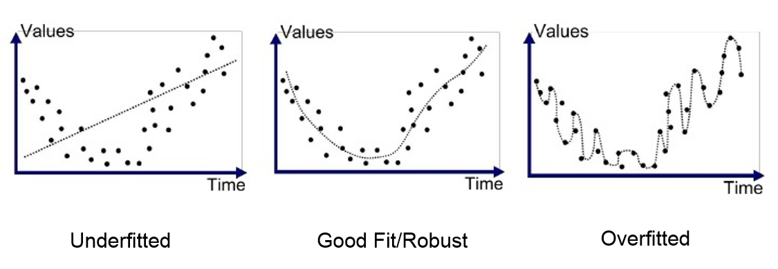
Overfitting
Model does well on data it has seen
Poorly on new data
Model fit too tightly to the specific data in the training set
It ‘memorized’ the answers in the training set, but did not find a generalized function for the problem
Image Source

Slide 27
Predict the sale price of a house
CodeAlong Colab Notebook
Solutions will be posted tomorrow. Remind me if I forget!

Slide 28
ChallengeNotebook

